Slide 1


Slide 2
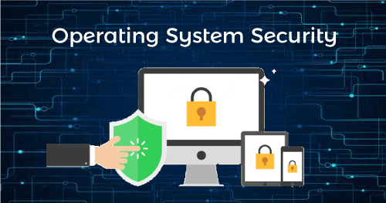
SECURITY ASPECTS OF Operating System
Name: Hina Urooj Malik
Roll no: 23L-7832
FAST NUCES Lahore

Slide 3
What is Security?
Just like we safeguard our valuable possessions in our daily lives to prevent theft, our computer systems also require protection.
So what is computer security? Protecting computer systems and data from damage, theft, and unauthorized use is the core of computer security. It involves keeping a watch out for and stopping illegal use of your computer system.
Operating systems are the most important software that runs on a computer. It manages the computer's memory and processes, as well as all of its software and hardware. It also allows you to communicate with the computer without knowing how to speak the computer's language.

Slide 4
What is operating system security
Since the operating system is the core component of a computer system, its security is always at danger unless it is properly guarded.
The term "operating system security" describes the specific procedures or defences against threats, malware, worms, viruses, and remote hacker incursions. OS security includes all preventive-control strategies that guard against any computer asset being lost, altered, or stolen in the event that OS security is breached.
Operating system security is the process of ensuring OS integrity, confidentiality and availability.
Notes:
sw

Slide 5
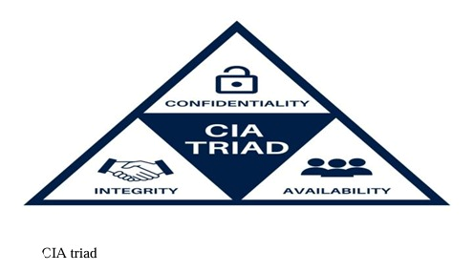
CIA Triad
Confidentiality
Maintaining confidentiality helps to prevent unwanted access to or disclosure of private information. Purpose is to stop unauthorized people or programs from viewing or using private information.
Availability
It guarantees the regular accessibility and functionality of a system or resource when required. Purpose to Protect against disruption, failures, or denial-of-service attacks that can impair users' or system access ability.
Integrity:
Integrity guarantees that data and system resources are reliable and accurate. Purpose to Prevents data or system files from being altered, deleted, or corrupted without authorization.

Slide 6
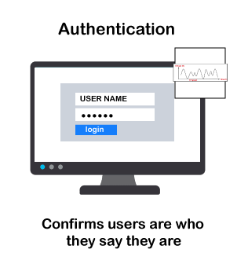
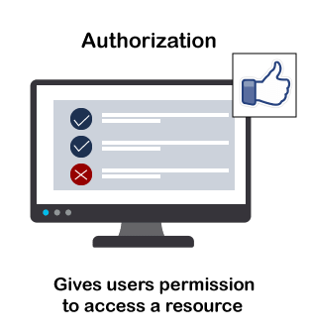
Authentication vs authorization
AUTHENTICATION | AUTHORIZATION
Users' identities are verified during the authentication process in order to grant them access to the system. | The person's or user's authority is verified during the authorization procedure to grant access to the resources.
In the authentication process, users or persons are verified. (identify by username, pass, fingerprint, face) | While in this process, users or persons are validated. (access rights to resources by using roles -pre-defined)
It needs usually the user’s login details. | However, it requires the user's security/permission levels.
It determines whether the person is a user or not. | It determines What permission does the user have?
Popular Authentication Techniques- Password-Based Authentication Password-less Authentication 2FA/MFA (Two-Factor Authentication / Multi-Factor Authentication) Single sign-on (SSO) | Popular Authorization Techniques: Role-Based Access Controls (RBAC) JSON web token (JWT) Authorization SAML(Security assertion markup lang.f) Authorization OpenID Authorization OAuth 2.0 Authorization
The user authentication is visible at user end. | The user authorization is not visible at the user end.
E.g. Employees in a company are required to authenticate through the network before accessing their company email. | E.g. After an employee successfully authenticates, the system determines what information the employees are allowed to access.

Slide 7
Security And Privacy in Operating System
Security in OS
Operating system security refers to the policies and procedures put in place to protect the system, its parts, and the data it handles.
Access Control: Controlling and limiting access to resources according to user permissions and rights.
Authentication: Using passwords, fingerprints, or other techniques to confirm a user's identity and make sure they are who they say they are.
Authorization: Permissions are granted or denied to users depending on their verified identities.
Encryption: Sensitive information is protected using encryption, which transforms it into a code that only authorized parties can decode.
Firewall: Installing barriers to regulate and keep an eye on incoming and outgoing network traffic in order to stop unwanted access.
Intrusion Detection Systems (IDS): keeping an eye on and spotting unusual behavior or activity that might point to a security violation.

Slide 8
Security And Privacy in Operating System
Privacy in OS
Protecting users' private information and making sure their data is handled in a way that respects confidentiality are the two main goals of privacy in operating systems.
Data minimization: is the process of gathering and preserving the least amount of personal information required for system operation.
User Consent: Before collecting or processing a user's personal information, get their express consent.
Anonymization: is the process of deleting or encrypting personally identifying data to avoid being linked to a specific person.
Secure Communication: Making sure that operating system channels for communication are safe to avoid interception or eavesdropping.
Privacy Settings: Giving people the ability to adjust privacy settings and preferences to manage how their data is utilized.
Transparency: Giving information regarding data collection and processing procedures in an understandable and accessible manner.

Slide 9
Advancements in Security And Privacy
Privacy Hardened Linux Distros (Distributions)
The present piece analyses Linux operating systems or in Windows that put increased privacy and security first, concentrating on three variants in particular: Tails, Whonix, and Qubes OS. To strengthen the privacy of users and overall system security, these operating systems set themselves apart by integrating cutting-edge features like virtualization, division and interaction with the Tor network (short for The Onion Routing project—is an open-source privacy network that enables anonymous web browsing.
Tails, for example, is intended to operate as a live CD and provides users with the full set of applications needed for private internet surfing. It is difficult for users to install extra packages due to its strict security procedures, and it is strongly advised that they only install packages with low Common Weakness Enumerations (CWEs) - (less security weakness)

Slide 10
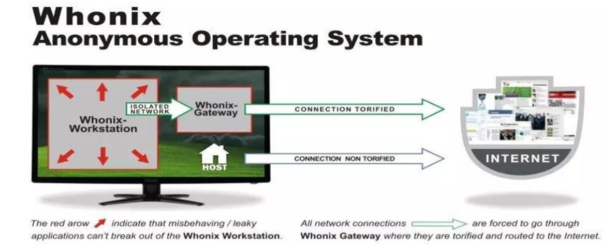
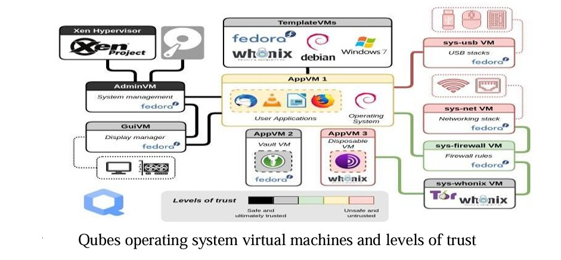
Whonix is an operating system that prioritises privacy and transmits all internet traffic via Tor. For increased security, it makes use of two virtual machines: a gateway for Tor connections and a workstation for user activity. It is advised to avoid executing system modifications in order to improve security. Whonix is intended for proficient in technology people who want the highest level of privacy when using the internet.
Qubes OS uses virtualization to construct several virtual machines (domains) for various purposes, with an emphasis on security through isolation. Dom0, a modified Fedora domain, serves as the foundation for these domains, which are administered by the Xen hypervisor. Every domain possesses distinct functions, configurations, and security settings. Although this architecture offers improved protection, it requires more complex setup and customization for users.

Slide 11
Advancements in Security And Privacy
Privacy – Cookie Law
Its purpose is to safeguard users' privacy online by ensuring that websites gain user consent before keeping or receiving any information.
Privacy – Usable Privacy
The importance of usability in privacy and security protocols. It uses commercial environments to show the risk of misconfiguration in systems that are too complicated.
Security – Mobile Operating System
The increased risks to mobile operating systems' privacy and security, particularly those with outdated software. Due to resource constraints, security measures in mobile systems require new research and methodologies that are different from those used in traditional computer operating systems.

Slide 12
Program Threats
Major Attacks in Operating System
Trojan Horses: A kind of malware that poses as trustworthy software in order to trick users into downloading and running it. Trojan horses cannot replicate like worms and viruses do. E.g. Zeus Trojan (steal banking info). To prevent the use of Anti-virus software.
Login Spoofing: Creating a false login interface with the intention of tricking users into disclosing sensitive information, like passwords and usernames. E.g. Phishing emails containing links to fake login pages. To prevent you must have an awareness between real and fake.
Buggy Software: Programmes or applications that have bugs, glitches, or programming mistakes that can cause unexpected behaviour. To prevent you must update recent security of OS and must check code before deploying.

Slide 13
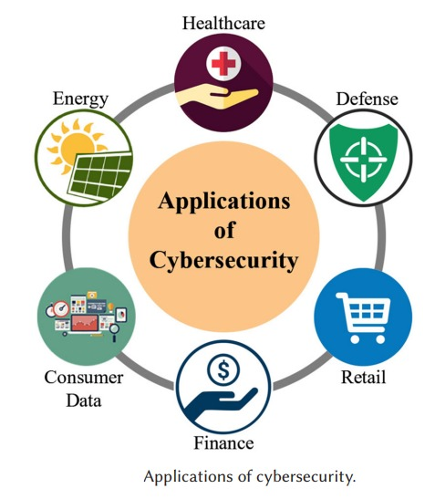
CYBERSECURITY
Cyber security is the practice of defending computers, servers, mobile devices, electronic systems, networks, and data from malicious attacks.
The importance of cybersecurity in shielding digital assets from online threats and illegal access. It highlights the wide variety of computing devices—from massive workstations to tiny Internet of Things devices (IoT) —that require cybersecurity safeguards.

Slide 14


